Slide 1
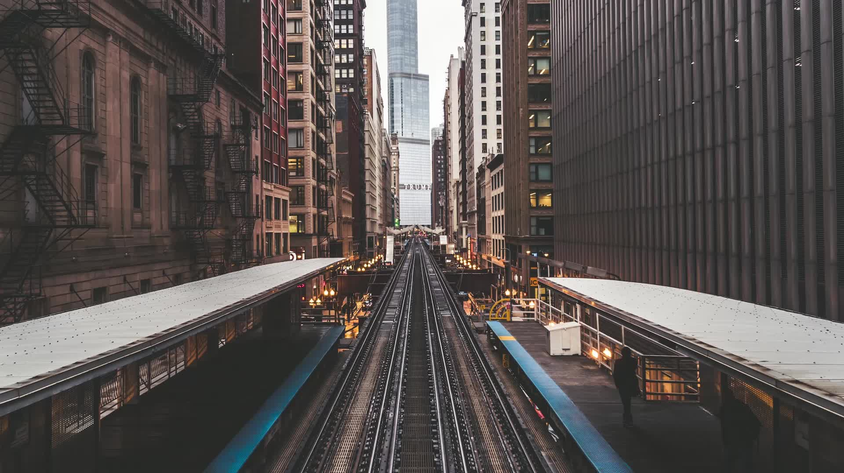
MTA Subway and NYC Demographics
And the success of the system to serve the city’s population.
Presentation By Sean Sirota
Updated to 12/31/2022

Slide 2
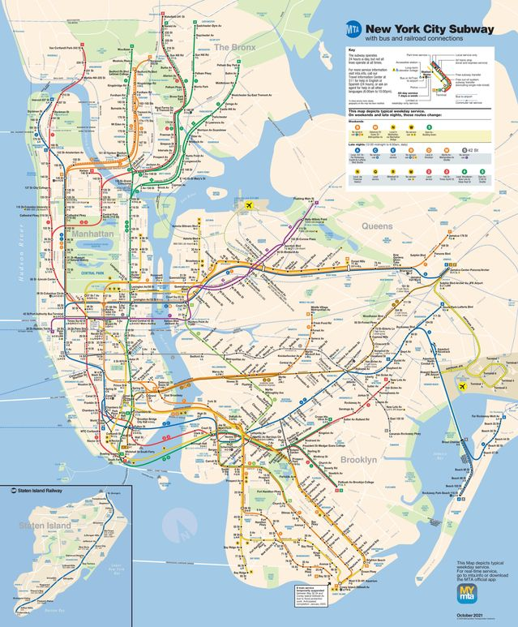
Introduction
The MTA (Metropolitan Transportation Authority) is the organization that operates the subway system in New York City.
The system spans 4 boroughs, consists of 472 stations (424 if you count station complexes), and 660 miles of track.
The system operates 24/7 and offers express services.

Slide 3
Objective
Measure the extent of how well the MTA subway serves the city’s general population.
Break down the city’s population into demographics and measure the effectiveness of the subway serving each one.
Investigate which population demographics benefit the most from the subway coverage and which ones need more service.

Slide 4
Overview of Data
Several data sources were used in this case study to perform the data analysis correctly and accurately.
2019 MTA subway ridership data is available publicly on their website.
MTA subway station geo-spatial data was found open-source by a contributor who mapped all stations to coordinates by longitude and latitude.
2020 US Census data is available publicly and was used to access population density, demographics, and census tract geo-spatial data.
Staten Island, one of the five boroughs of New York City, was excluded from this case study because it lacks any subway stations.

Slide 5
Overview of Methods
Most of the data cleaning, data analysis, and data visualization was completed in R-Studio.
Microsoft Excel was used for some tasks such as merging MTA subway ridership data with MTA station location data of different formats.
All data was loaded and manipulated as CSV (Comma-separated values) files that consisted of tables which can be easily converted into data frames for use in R-Studio.

Slide 6
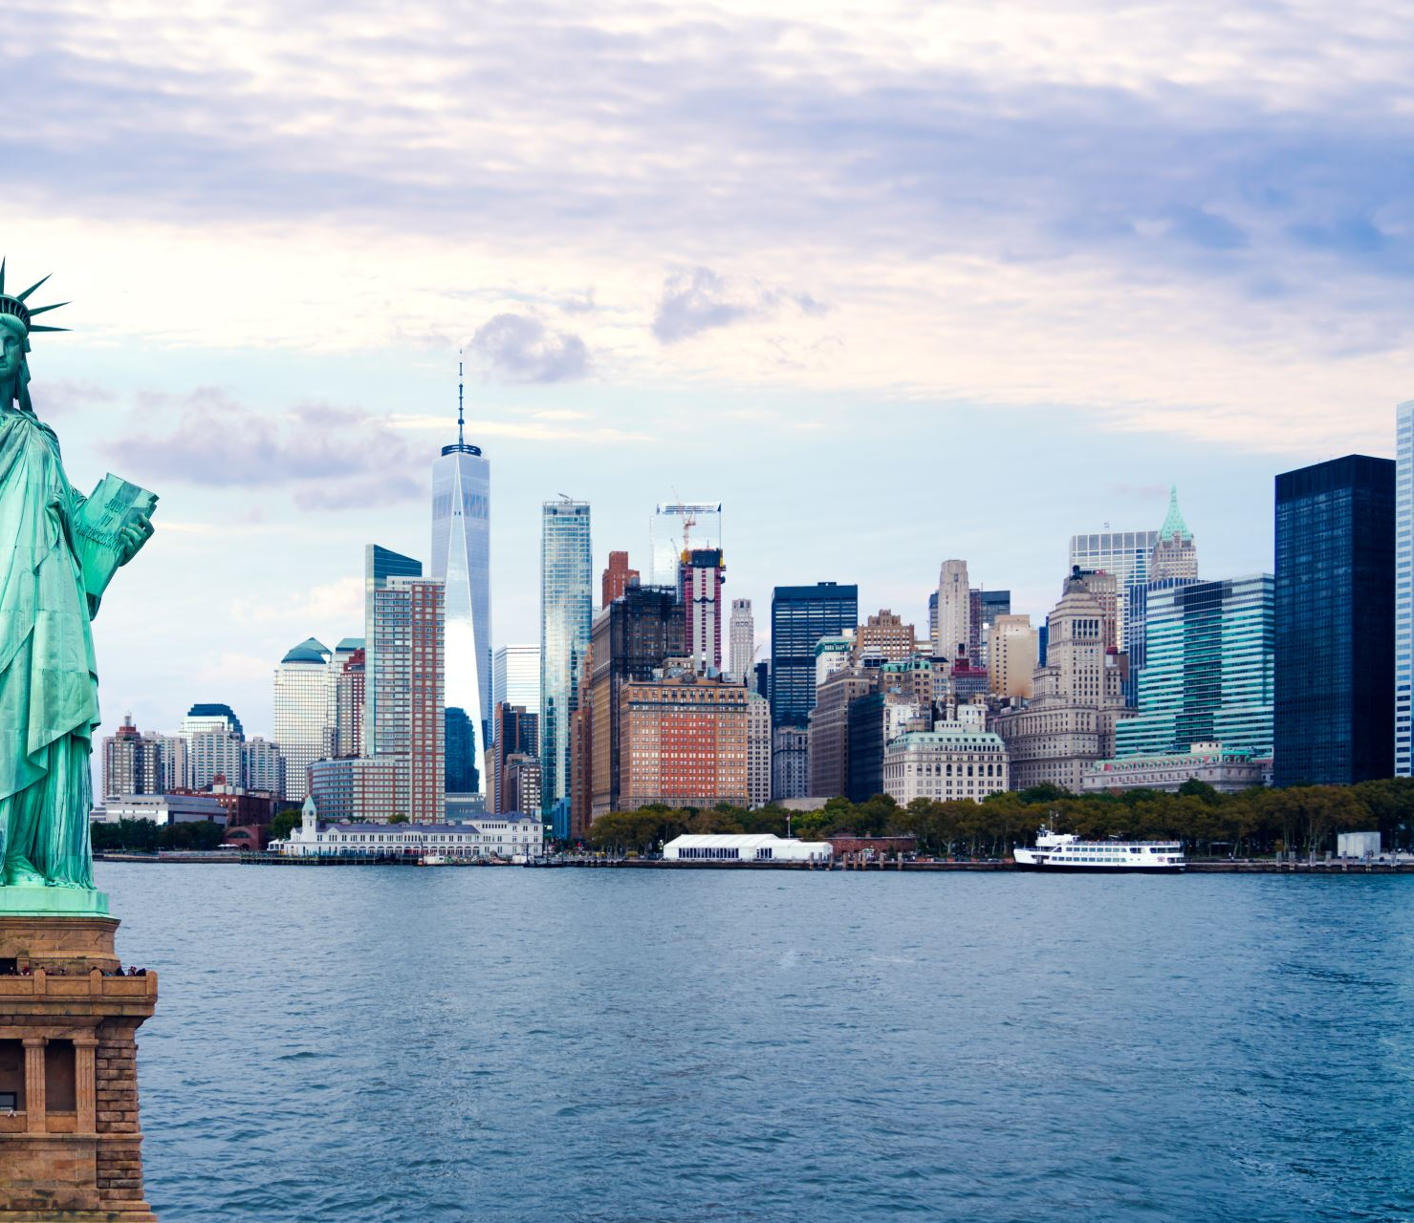
Introduction: Exploring the MTA Subway Network and New York City Demographics

Slide 7
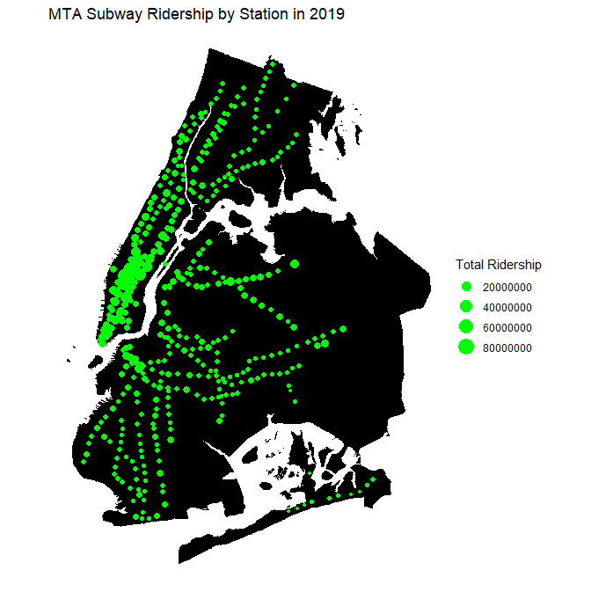
MTA Subway Ridership
Central Park
Ridership of the subway system in 2019 was 1.698 billion riders.
Stations are green dots on top of the four boroughs of the city.
Larger green dots signify greater ridership than smaller green dots.
Most of the highest ridership stations are congregated in Manhattan, especially south of Central Park.
Most of the city is well covered with the subway except for southeastern Brooklyn and eastern Queens.
Bronx
Manhattan
Queens
Brooklyn

Slide 8
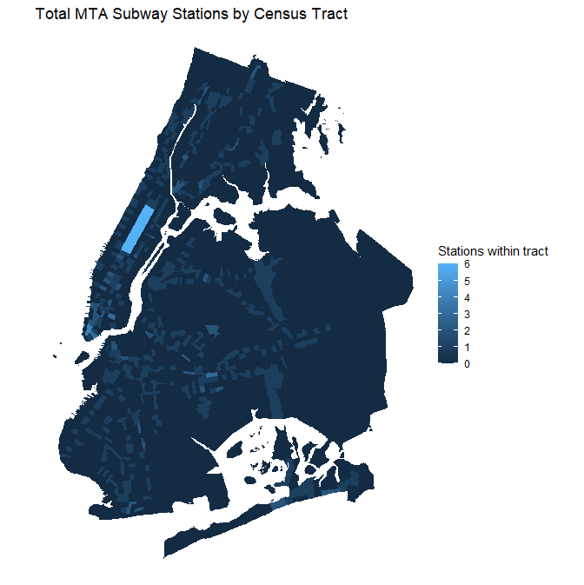
MTA Subway Ridership – Cont’d
Central Park
Lighter colored census tracts contain more subway stations within them than darker ones.
Manhattan clearly has the greatest concentration of subway stations in the city, especially around Downtown, Midtown, and Central Park.
The outer boroughs contain lower densities of subway stations, but coverage is still high in parts closest to Manhattan.
Midtown
Downtown

Slide 9
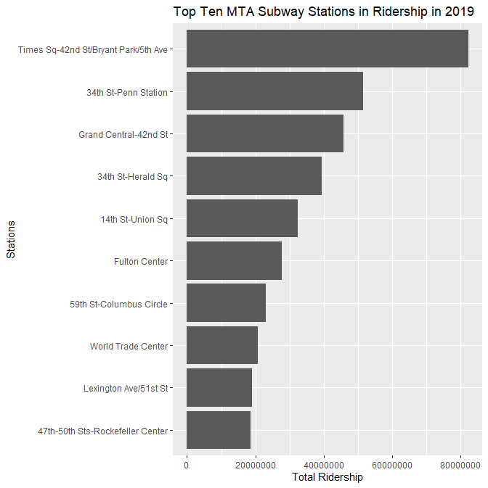
MTA Subway Ridership – Cont’d
The stations with the highest ridership in the system are mostly located in Manhattan.
The top ten stations with the highest ridership are all station complexes within Manhattan consisting of several smaller stations on different lines converging together in one place.
Number 1 on the list, Times Square, is a converging of 5 different subway lines.
Number 2, Penn Station, is a converging of 2 subway lines and is a major long-distance and suburban rail station.
Number 3, Grand Central, is a converging of 3 subway lines and is also a major suburban rail station.

Slide 10
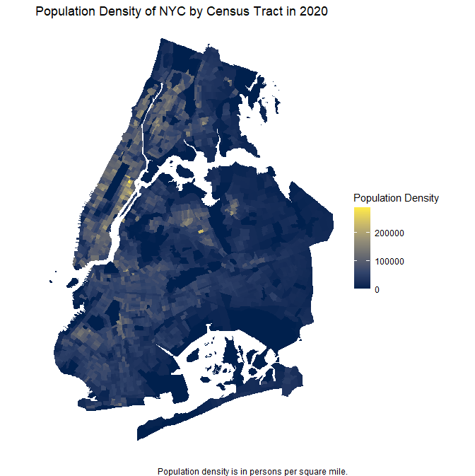
Population and Demographics
Bronx
Upper East Side
Population density, which is measured in persons per square mile, allows you to see the greatest congregation of people living within the city.
All of Manhattan is extremely densely populated, especially in the Upper East Side.
Brooklyn is also generally densely populated but to a lesser extent compared to Manhattan.
Queens has the greatest population density in the western half.
The Bronx also is most populated in the western parts, closest to Manhattan.
Manhattan
Queens
Brooklyn

Slide 11
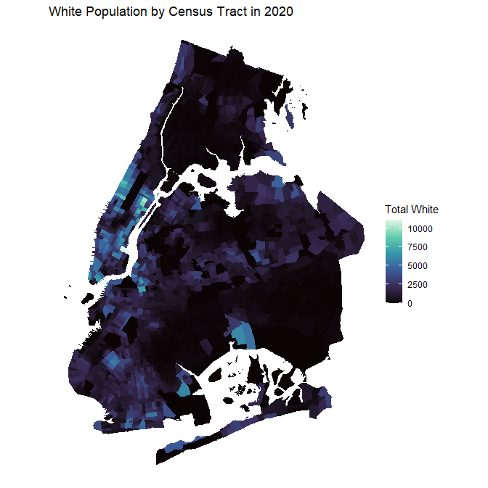
Population and Demographics – Cont’d
Harlem
Demographics can also be shown by population on a map.
The White demographic makes up most of lower Manhattan below Harlem.
Western Brooklyn, northern Queens, and some parts of eastern Bronx also have some White populations.

Slide 12
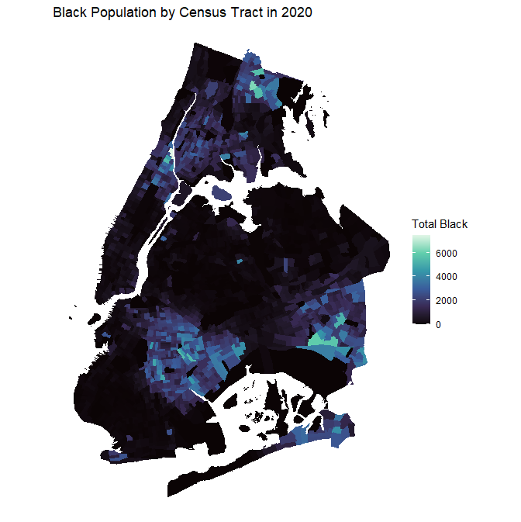
Population and Demographics – Cont’d
Harlem
Most of the Black population in Manhattan is in Harlem.
Eastern Brooklyn, southeastern Queens, and southwestern and northern Bronx have the highest congregations of Black population in the outer boroughs.
Something of interest is that there is almost no overlap between the White and Black populations within the city.
This means that every area in the city is exclusively majority White or Black, but almost never both.

Slide 13
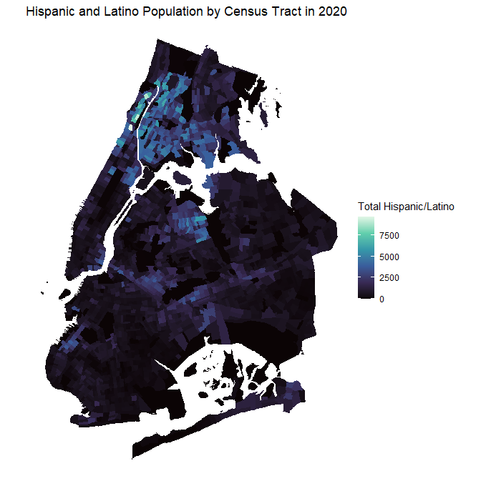
Population and Demographics – Cont’d
Corona
The main clusters of Hispanic and Latino populations in the city are in the southern and western Bronx and the far northern parts of Manhattan.
There are also smaller communities around northeastern Brooklyn, Sunset Park, and Corona, Queens.
Sunset Park

Slide 14
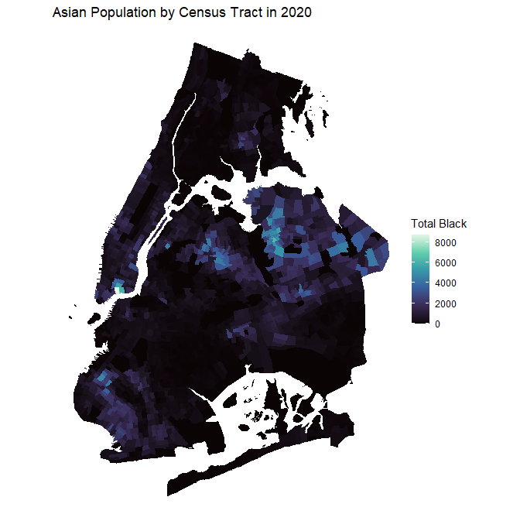
Population and Demographics – Cont’d
Parkchester
Elmhurst
Flushing
Asians are almost exclusively located in the Chinatown neighborhood in Manhattan.
They also inhabit southwestern Brooklyn and northern Queens, especially in Elmhurst and Flushing.
The Bronx is virtually empty of Asian populations except for a small cluster in Parkchester.
Chinatown

Slide 15
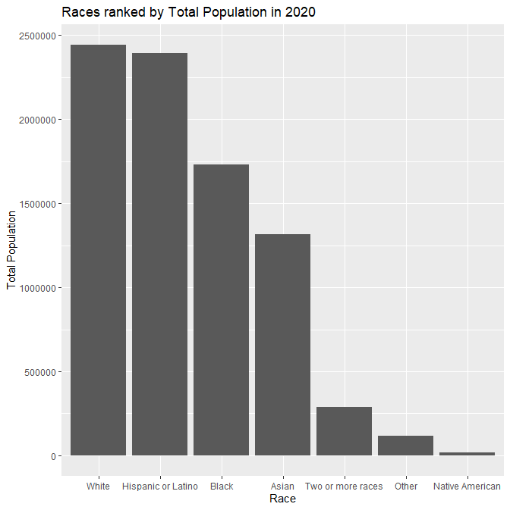
Population and Demographics – Cont’d
This chart shows the distribution of races within NYC.
Whites make up most of the city population with Hispanics and Latinos coming in second by a very thin margin.
Blacks and Asians follow as third and fourth.
These four races make up ~94% of the city population and thus are the focus of this case study.

Slide 16
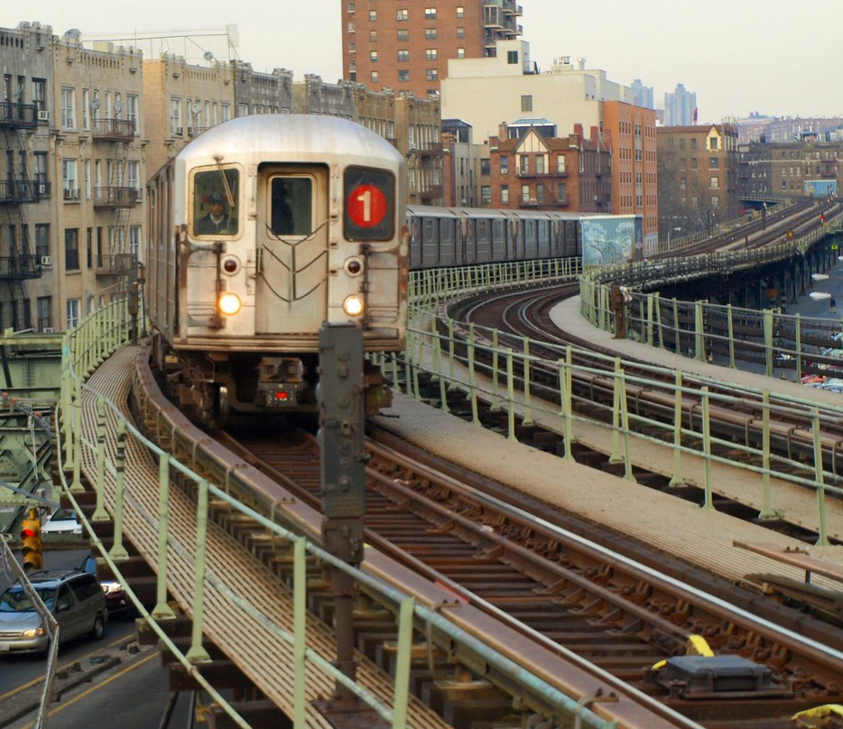
Analysis: Effectiveness of the MTA Subway on serving the NYC Population

Slide 17
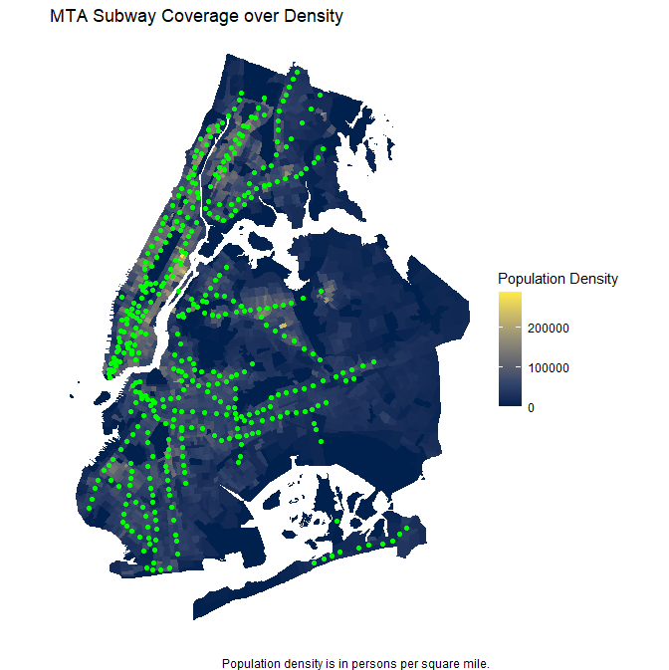
MTA Subway Coverage of Population
Third Avenue
Northern Boulevard
The MTA subway serves the city quite well when considering the nodes of high population density.
Almost every single zone of high population density is served by a subway station.
Some notable exceptions include the Third Avenue, Northern Boulevard, and Utica Avenue corridors.
It may be possible that the subway being built brought density to that area instead of the other way around.
Utica Avenue

Slide 18
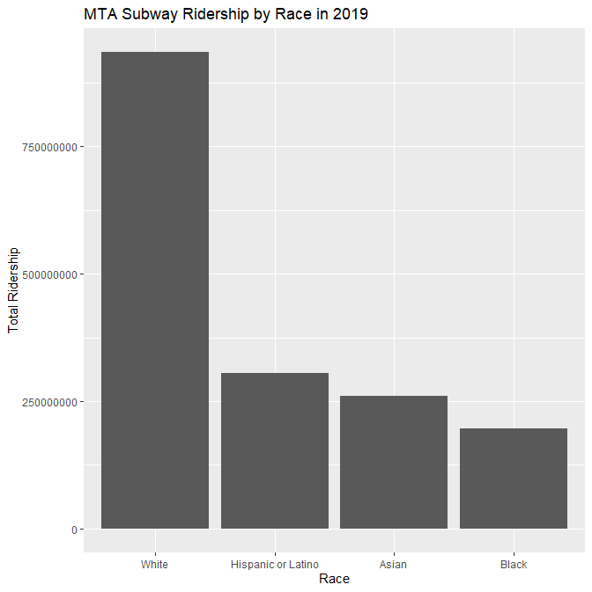
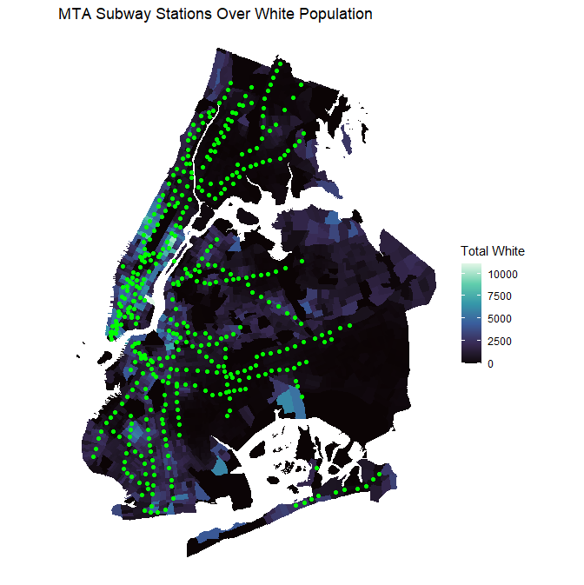
MTA Subway Coverage by Demographics
This map shows subway stations and the White dominated areas of the city.
Because ~32% of the White population of the city lives in Manhattan this population is well served in this one borough alone which has the best subway coverage.
Most of the other White dominated areas around the city are also well-served by the subway such as western and northern Brooklyn.

Slide 19
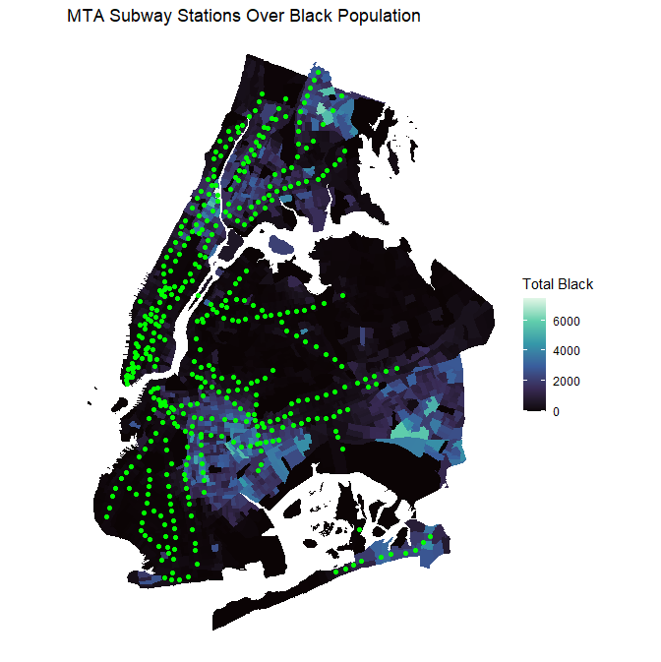
MTA Subway Coverage by Demographics – Cont’d
Third Avenue
Harlem
Manhattan once again has the best coverage for the Black population centers as the subway covers virtually all of Harlem.
The Bronx and Brooklyn also have decent coverage by subway stations with exceptions of Third Avenue in the Bronx and Utica Avenue in Brooklyn.
Queens not only has the least subway coverage in general, but the Black population centers are largely missed in southeastern queens with exception of the Far Rockaway neighborhood.
Far Rockaway
Utica Avenue

Slide 20
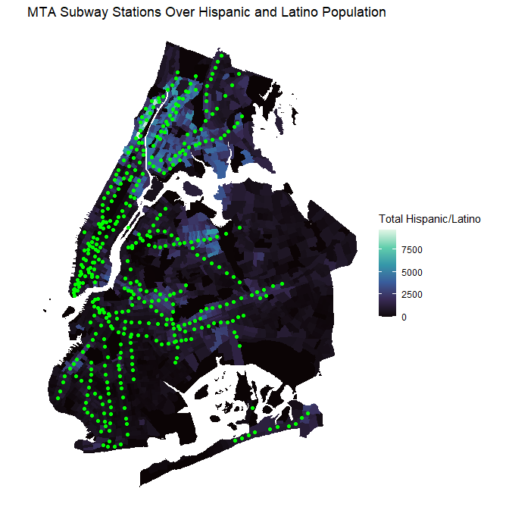
MTA Subway Coverage by Demographics – Cont’d
Third Avenue
North Corona
Most of the Hispanic and Latino population in the city is in the Bronx as ~34% of the population lives there.
The Bronx Hispanic and Latino population is covered moderately well, save for Third Avenue and the southeastern parts of the borough.
Brooklyn and Manhattan Hispanic and Latino populations are also served well by the subway.
The subway serves the Queens Hispanic and Latino population the least well. Much of the North Corona neighborhood remains underserved.

Slide 21
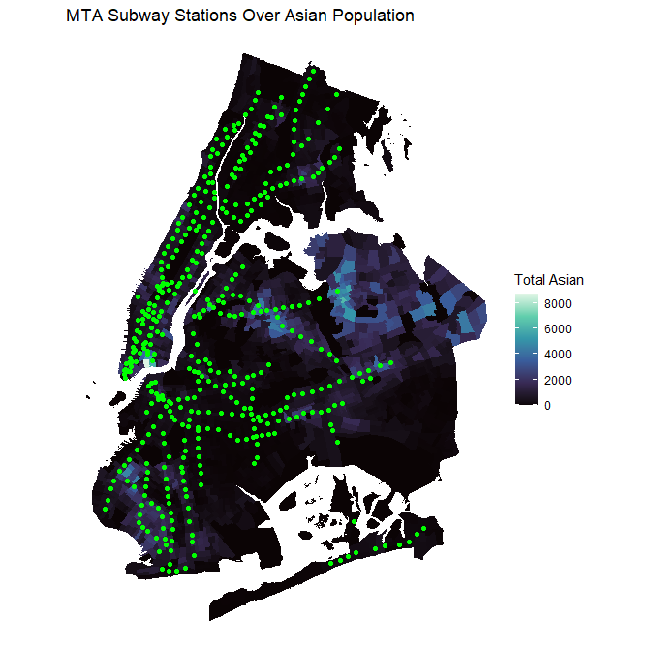
MTA Subway Coverage by Demographics – Cont’d
Flushing
Queens is the borough with the highest population of Asians by far at ~50%.
However, most of the Queens Asian population is underserved. Much of northeastern Queens has very few subway stations except for one station in the Flushing neighborhood.
The subway serves the Brooklyn and Manhattan populations well; the neighborhoods of Bensonhurst and Sunset Park, Brooklyn and Chinatown, Manhattan have plenty of stations in the area.
The Bronx has a very small Asian population, so the subway there has no significant ridership from them.
Chinatown
Sunset Park
Bensonhurst

Slide 22
MTA Subway Coverage by Demographics – Cont’d
This chart shows the demographics of riders of the subway by race.
The White population of NYC clearly rides the system more than any other race.
However, this does not mean that other races don’t ride the subway as much. It’s evident from the previous maps that other races aren’t served as well by the subway.
There may be historical reasons for this such as the subway being built through immigrant European settlements in the core of the city which still exist to this day.

Slide 23
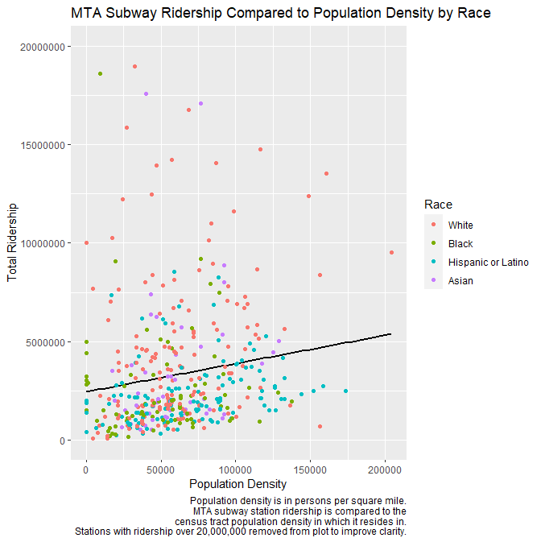
Comparing MTA Ridership to Demographic Profiles
This chart compares the total ridership of every station by the population density of the census tract it serves.
Each station is also colored by the main demographic it serves.
While the trend is weak, its clear that stations with higher population density are correlated with higher ridership.
Stations in White dominated areas generally have the highest ridership. Hispanic/Latino and Black dominated areas have the lowest.

Slide 24
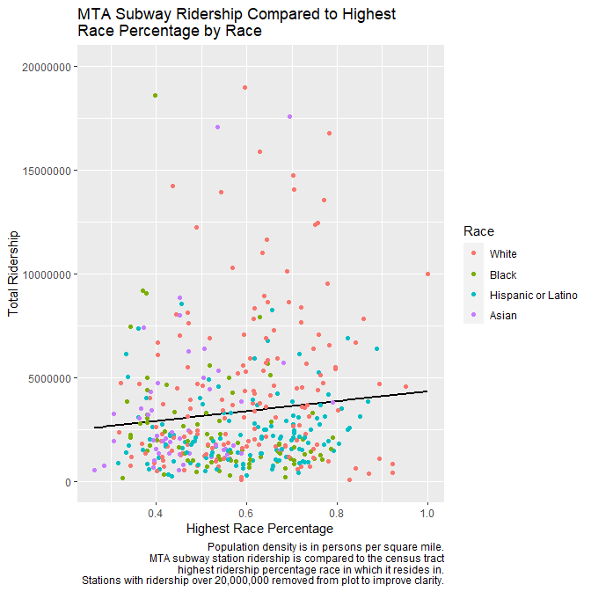
Comparing MTA Ridership to Demographic Profiles – Cont’d
This chart compares the total ridership of every station by the race with the highest percentage of the population in that census tract.
Stations with a higher race percentage have the least diversity in that census tract since that race dominates it so greatly.
Stations that have a higher race percentage are more often White dominated than any other group.
Asian dominated stations usually have the lowest race percentage and are more diverse in their demographics.

Slide 25
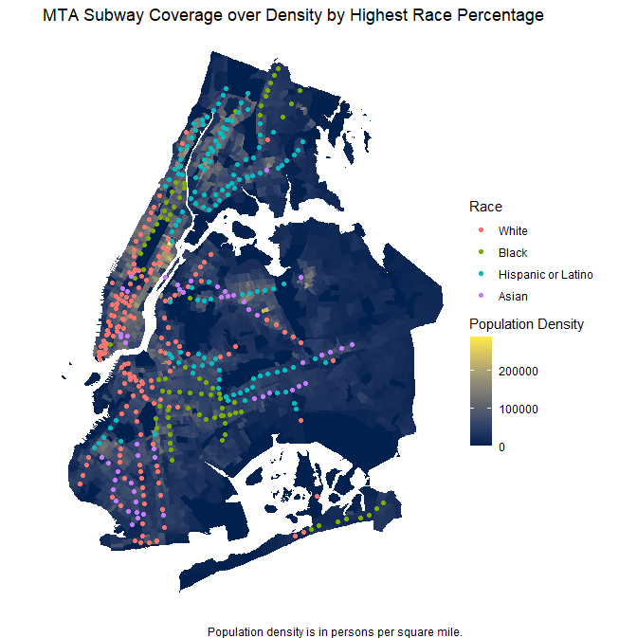
Comparing MTA Ridership to Demographic Profiles – Cont’d
This map shows every station colored by the dominant demographic serving it on top of a population density map of the city.
This map confirms the dominance of the White demographic being served by the subway. 164 stations serve White dominated census tracts. They makes up ~39% of all stations in the system.
Manhattan and the Bronx are the least diverse, serving mainly White and Hispanic/Latino respectively.
Brooklyn and Queens are the opposite and have a strong diversity of races.

Slide 26
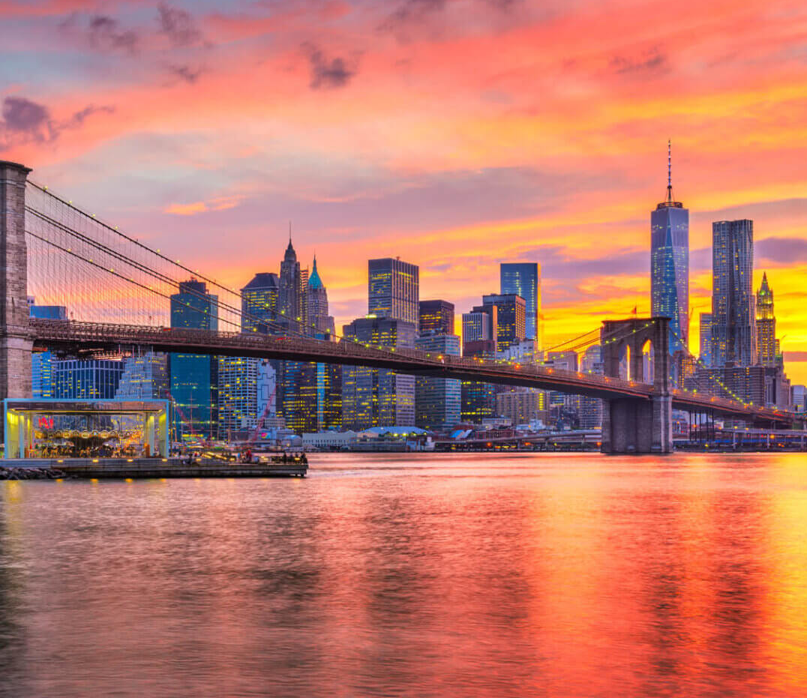
Conclusion: Takeaways and Solutions to Improve the MTA Subway System

Slide 27
Takeaways
The MTA subway system serves most of the densely populated areas of New York City well.
The White demographic makes up most of the subway ridership and is best served by the system.
Other demographics aren’t served nearly as well, especially in the areas farthest away from Manhattan where many of them reside.
Southeastern Brooklyn and most of eastern Queens have very few subway stations despite having the largest clusters of minority populations.

Slide 28
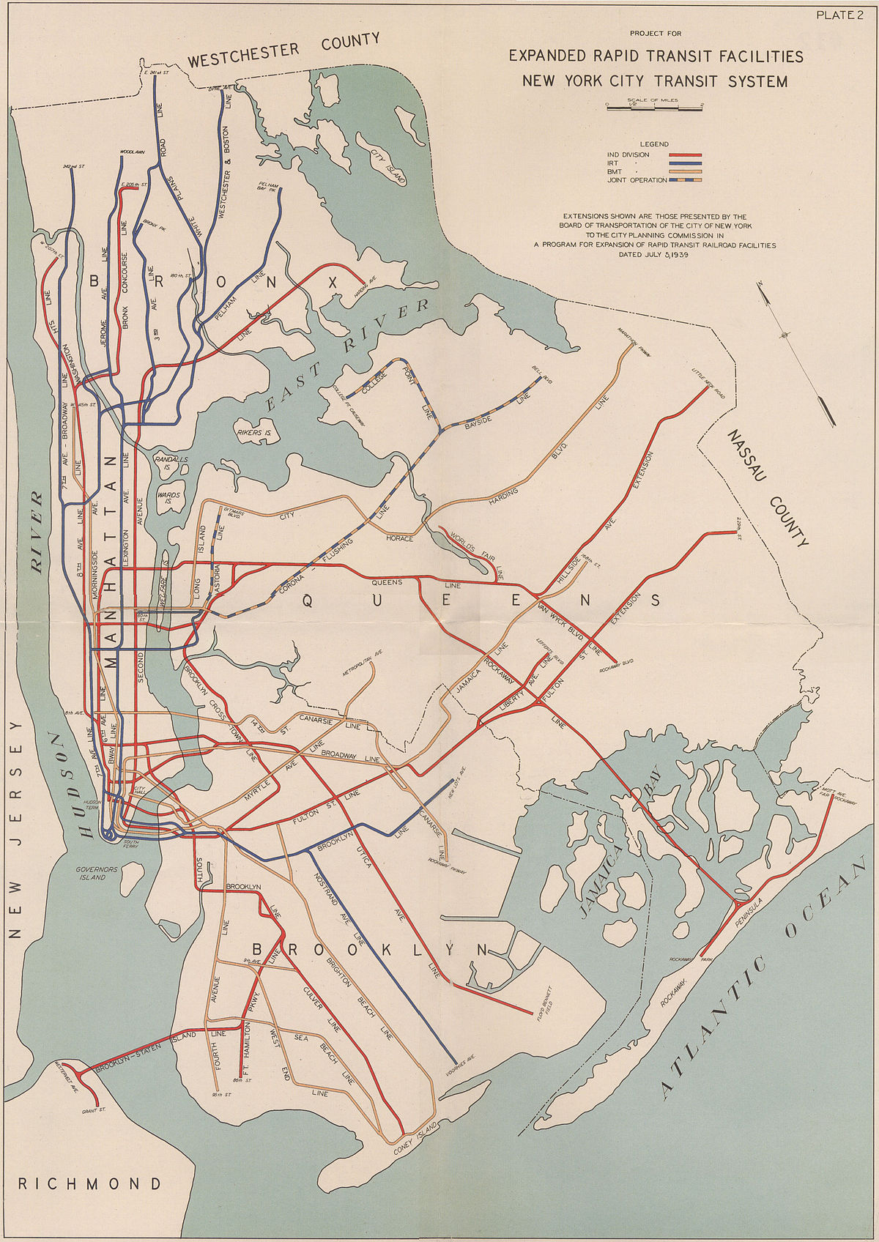
Solutions
In order to bring equity to the city and give minority demographics the service they deserve, the system needs to be expanded.
New lines and stations on Third Avenue in the Bronx, Northern Boulevard in Queens, and Utica Avenue in Brooklyn could all go a long way in addressing these unserved communities.
One solution that was suggested in the past is the 1939 “Second System” plan as shown right.
This plan would’ve had the system expand greatly and covered virtually all the unserved areas of the city.
While such a plan would be very expensive to implement, some of these new lines could be funded and built in stages to spread costs over time.

Slide 29
Topics of Further Investigation
This case study covered the relationships between the MTA subway and the population and demographics of New York City. More topics to study which could add to the research done here include the following:
Investigate if income levels of different demographics could affect the ridership of the subway and where these people live in the city.
Look into historical settlement patterns of different demographics and see how they changed over time and if any trends can be found.
Consider other modes of transit for these unserved areas of the city if the population density and cost can’t justify subway expansion.

Slide 30

Thank you!

